Slide 1
The Role of Interaction Interaction
R. Jordan Crouser
MassMutual Faculty Fellow
Statistical & Data Sciences Program
Smith College

Slide 2
Outline
Mini-lab: #badviz
Interaction and Analysis
Definition
Interaction with data and problem space
Interaction with visual interfaces
BREAK
Introduction to D3

Slide 3
Mini-lab: #badviz
Break into groups of 2-3 people, and go to:
www.science.smith.edu/~jcrouser/SDS136/labs/design
Goal: critique some professionally-made visualizations
Try to think about the following questions:
What is the first thing you notice about this visualization?
What point is this visualization trying to make?
Who is the intended audience?
What is the visualization doing well?
What problems do you see with the visualization design?
Why do you think the designer made those choices?

Slide 4
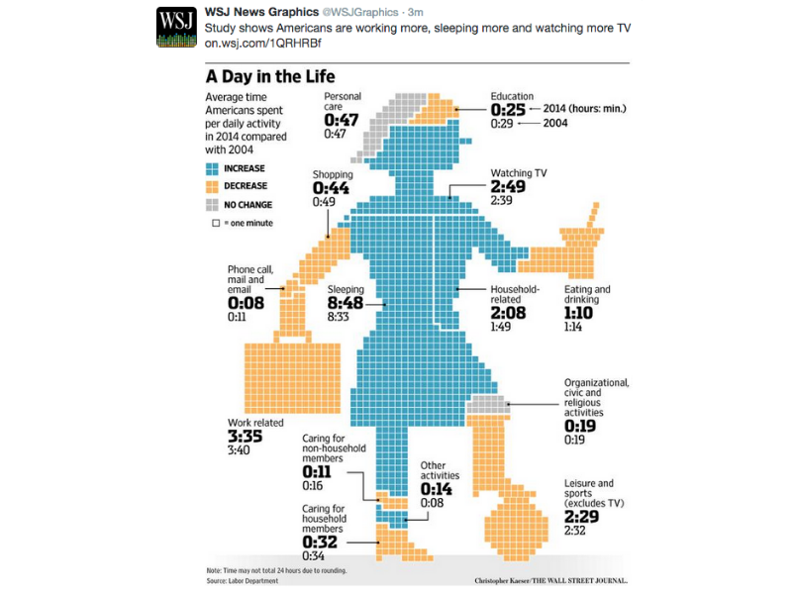

Slide 5


Slide 6
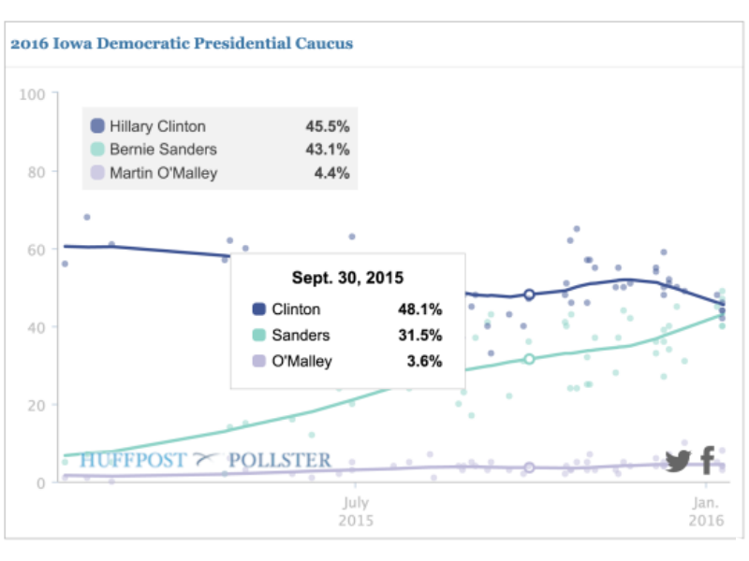

Slide 7
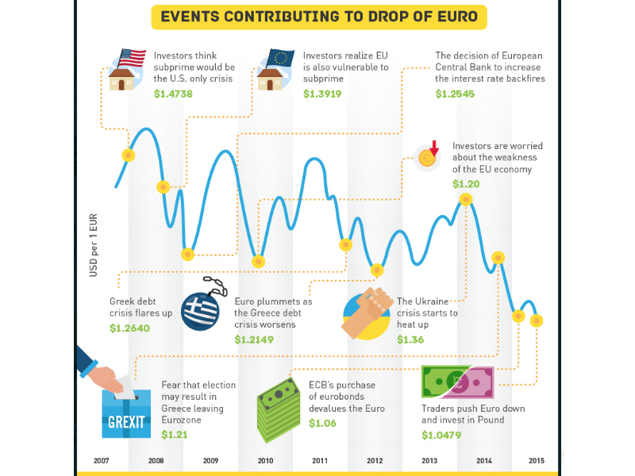

Slide 8


Slide 9
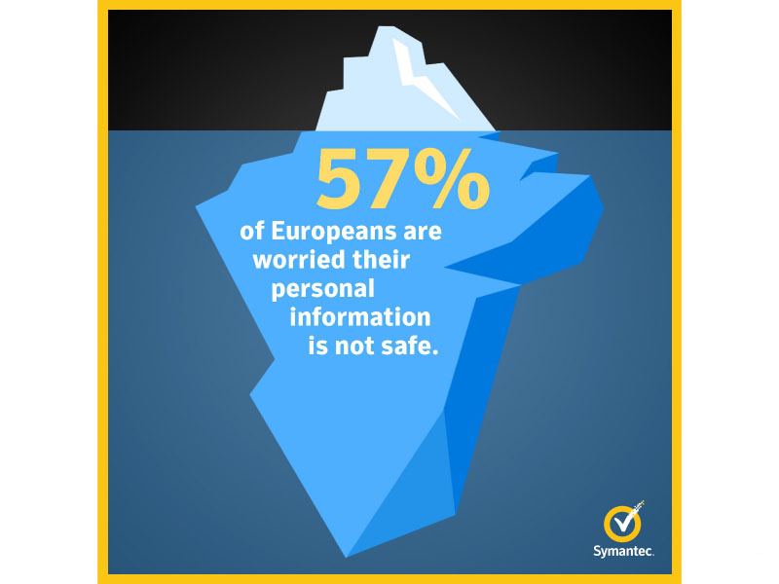

Slide 10
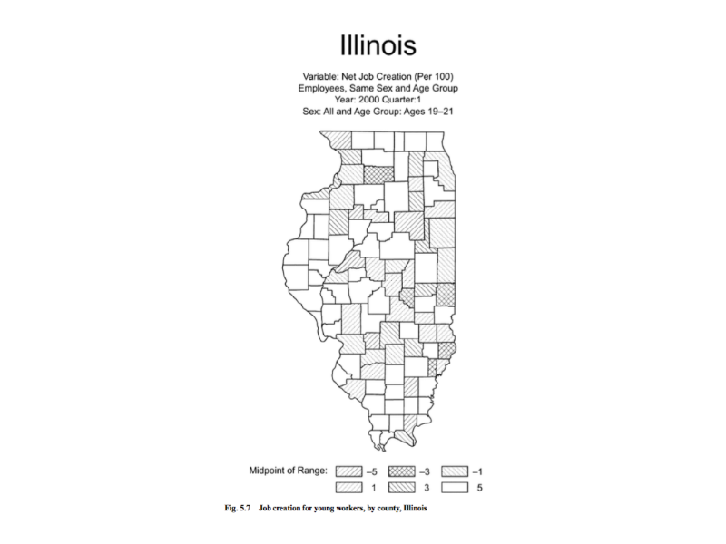

Slide 11
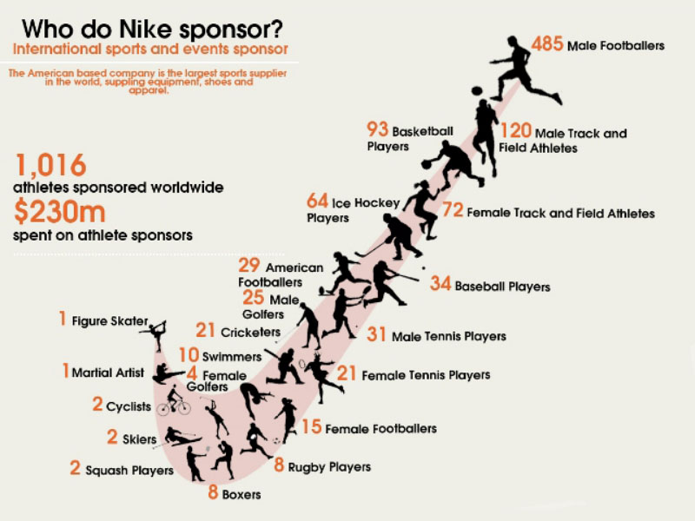

Slide 12


Slide 13
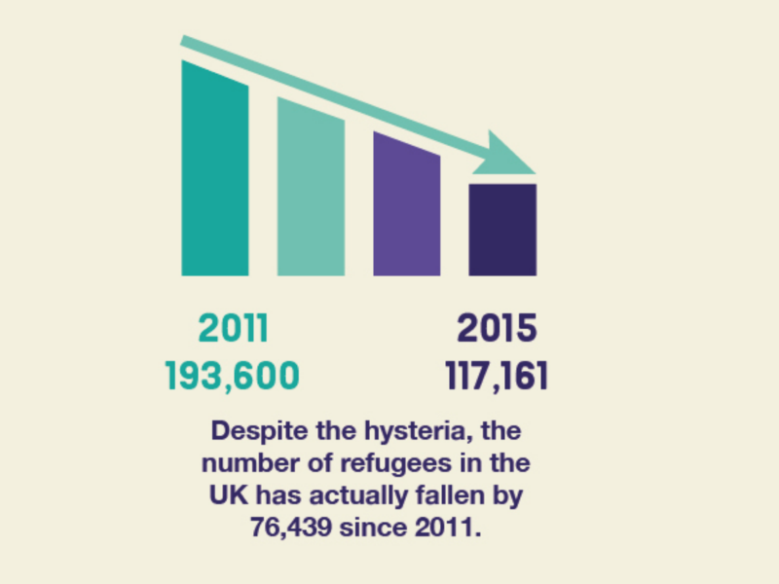

Slide 14
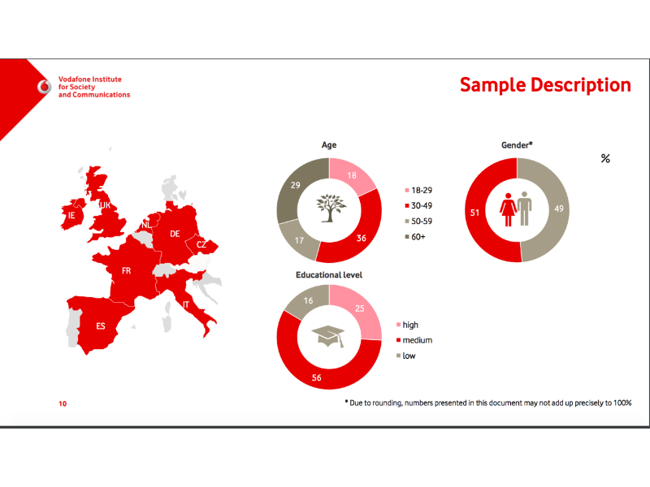

Slide 15
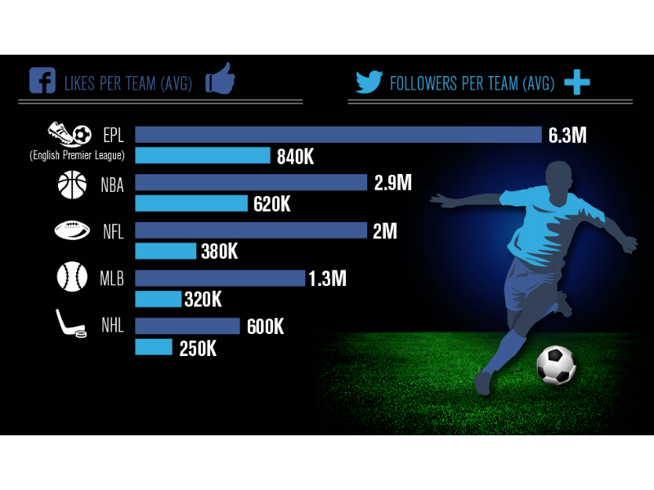

Slide 16
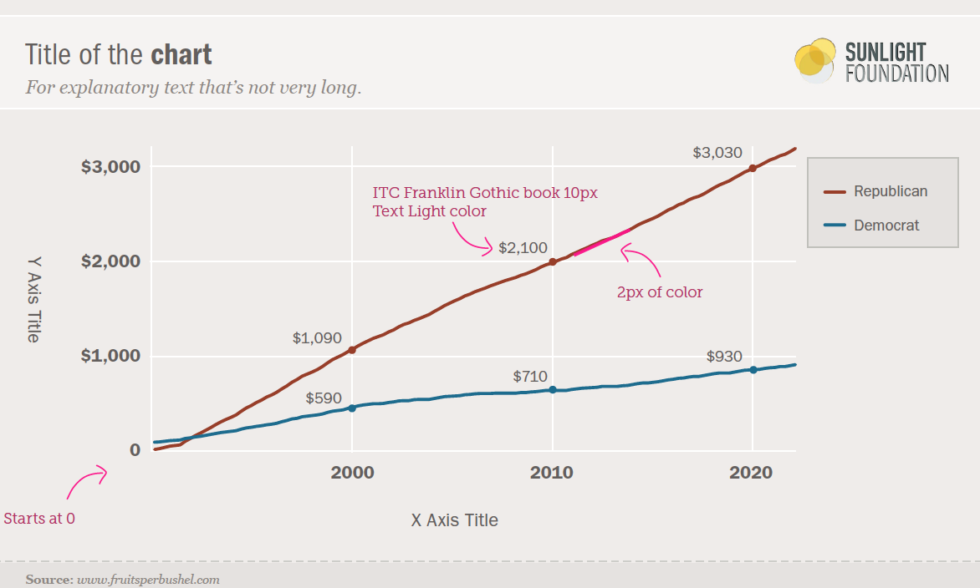
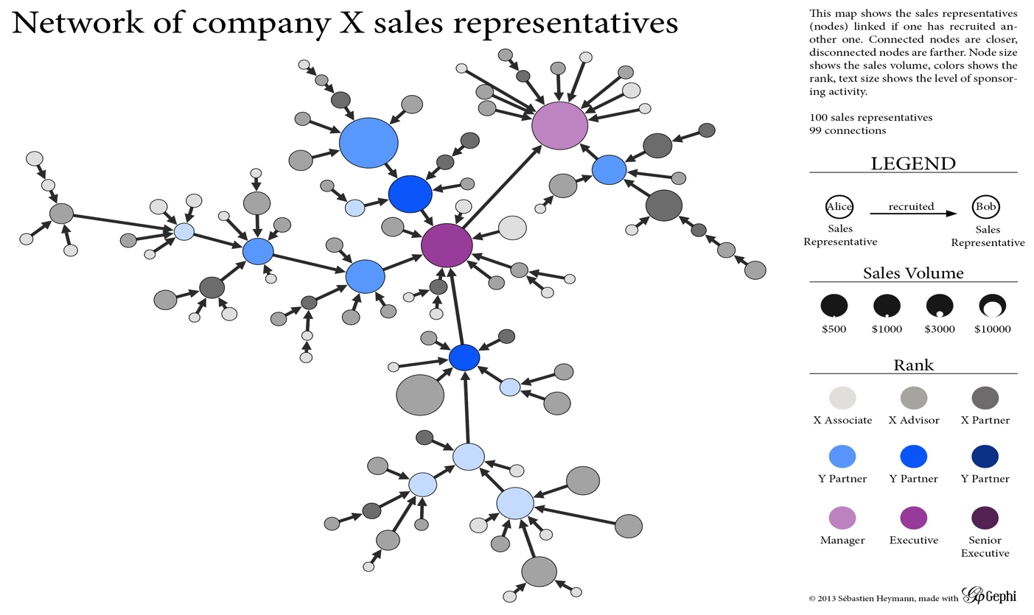
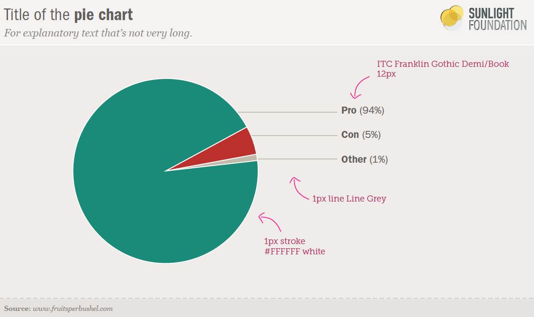
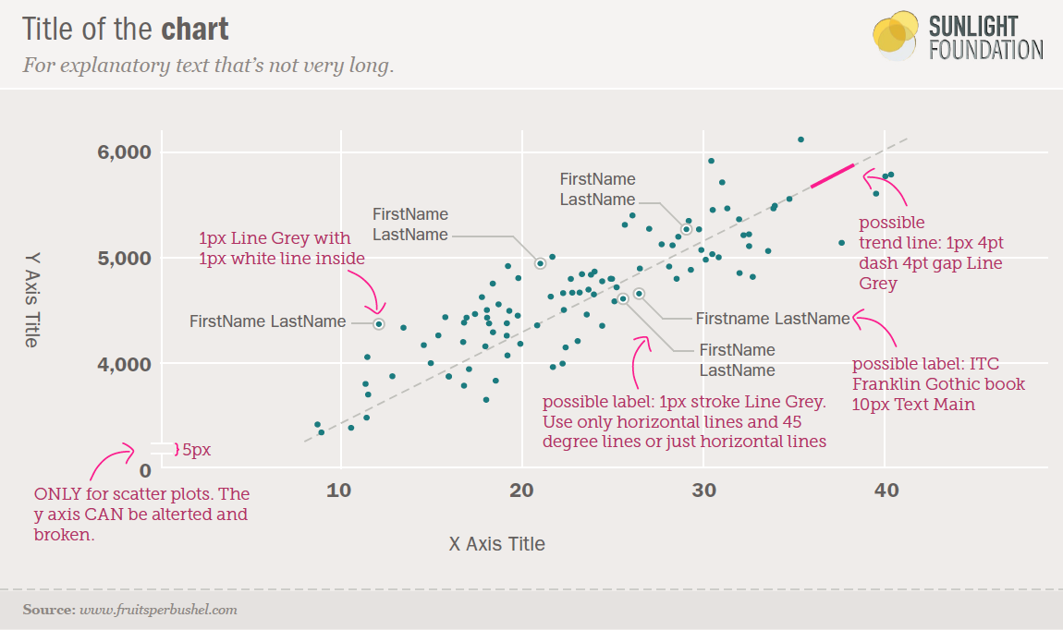
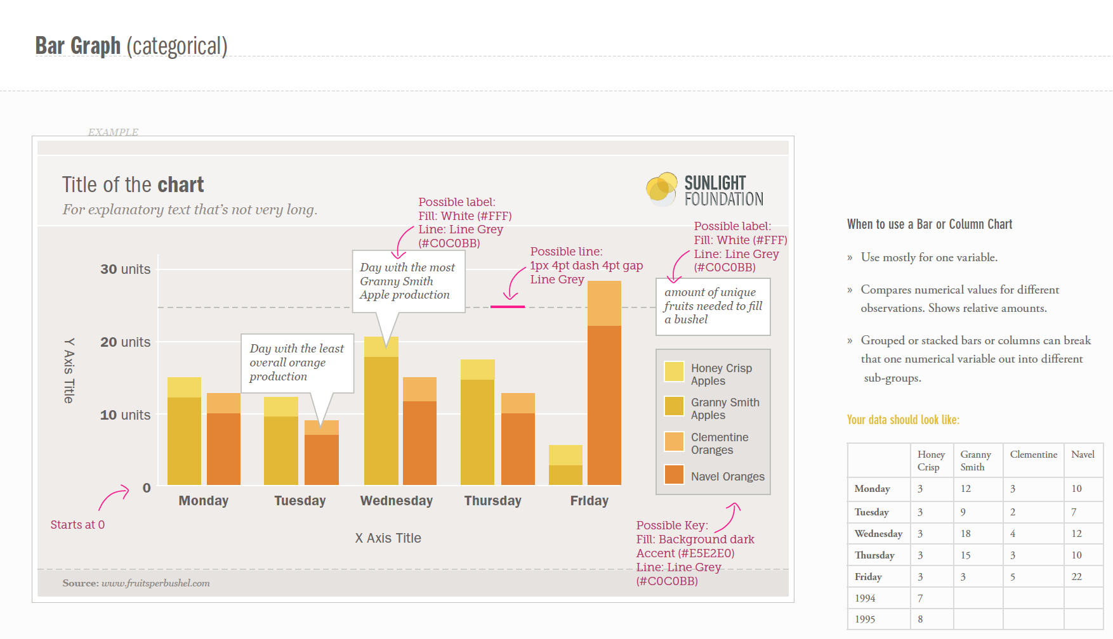
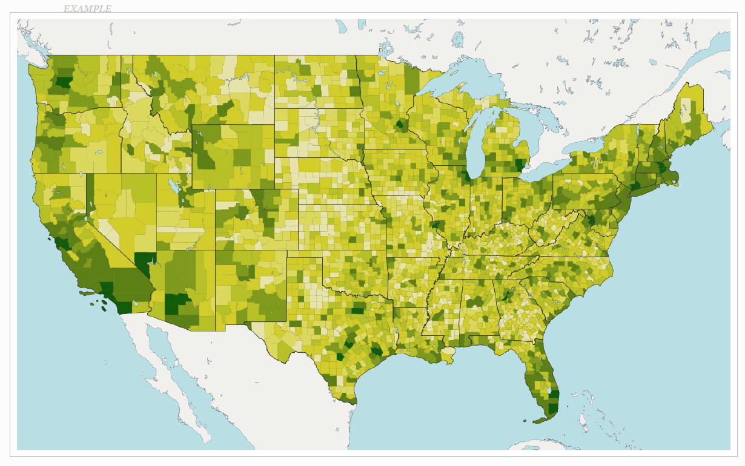
So far: Information Visualization

Slide 17
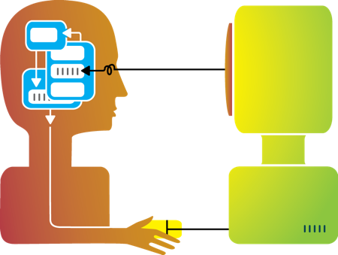
Flashback: about this workshop
Visualization
Interaction
Design
Interaction
Design

Slide 18
Interaction (def.)
Methods by which humans create knowledge through the manipulation of an interface
Low level: between human and interface
the set of operations available
the relationship between the human and the visualization
High level: between human and problem space
a cognitive act enabled by the tool
does not need to take place exclusively within them
might be distributed across multiple tools

Slide 19
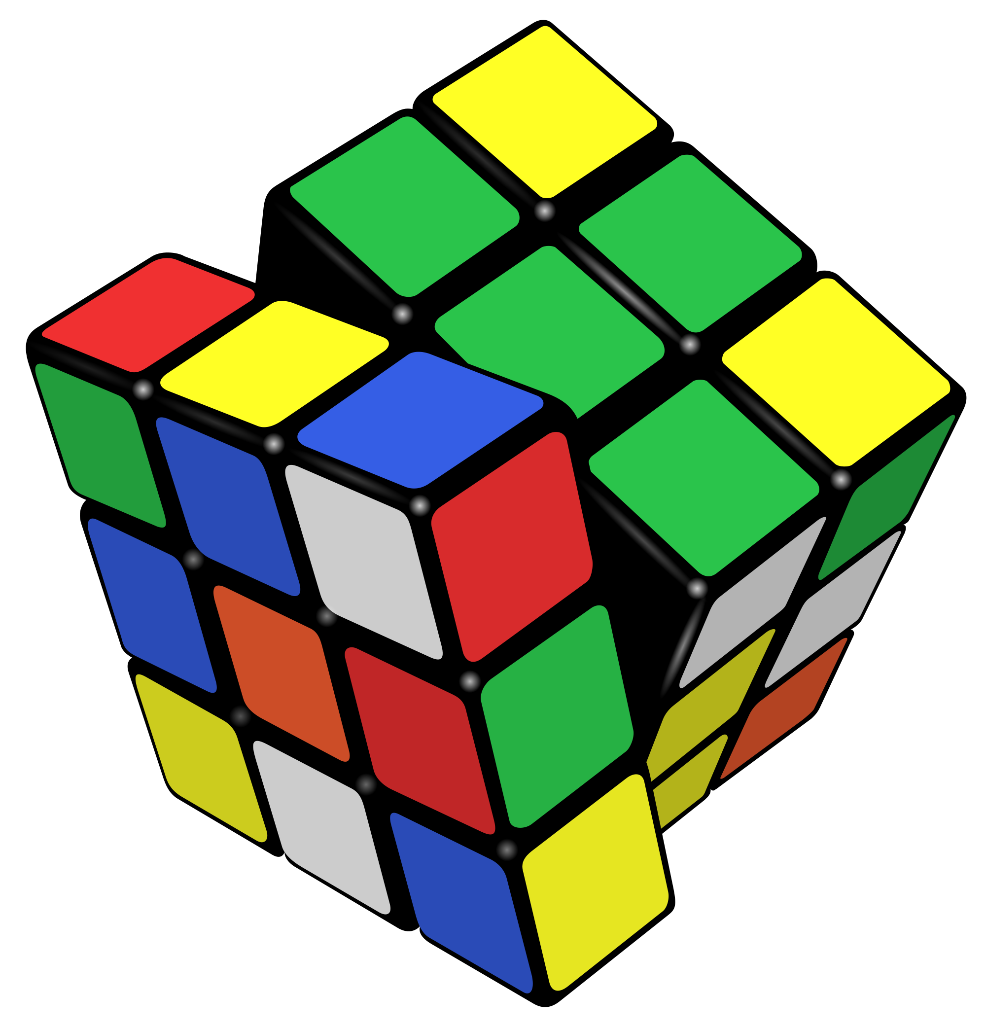
Example: Rubik’s Cube
What low-level interactions can you have?
What high-level interactions can you have?

Slide 20
Interaction and Analysis
Interaction is the observable result of a cognitive process: “an externalization of thought”
In visual analytics, there is a growing belief that interaction and analysis are one in the same
Analytic discourse: the idea that knowledge is constructed, tested, refined, and shared through the interactive manipulation of a visual interface¹
¹Pike, W. A., Stasko, J., Chang, R., & O'Connell, T. A. (2009).
The science of interaction. Information Visualization, 8(4), 263-274.

Slide 21
Part I: High Level
Interaction with
Data / Problem Space

Slide 22
Interaction as a Reasoning Aid
Interaction is situated in the context of a problem or goal-directed activity
This context helps the human identify relevant concepts and link them into appropriate structures
Interaction brings together background contexts and current observations
This is known as “situated cognition”

Slide 23
Sanity Check
Hypothesis: the more ways a user can ‘touch’ their data (by changing their form or exploring them from different perspectives), the more insight will accumulate.

Slide 24

Interaction as Distributed Cognition
Visualization is often used as a tool to “offload” storage or computation from the human’s brain
In order for this to be useful, we have to be able to “reload” parts of the data and operate on it
Internal (in your head) vs. external (on the screen) representations
Consider the impact of the affordances of the interface

Slide 25
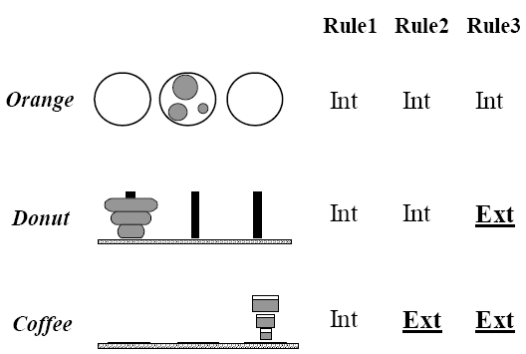
Example: Tower of Hanoi
Only one disk can be transferred at a time.
A disk can only be transferred to a pole on which it will be the largest.
Only the largest disk on a pole can be transferred to another pole.

Slide 26
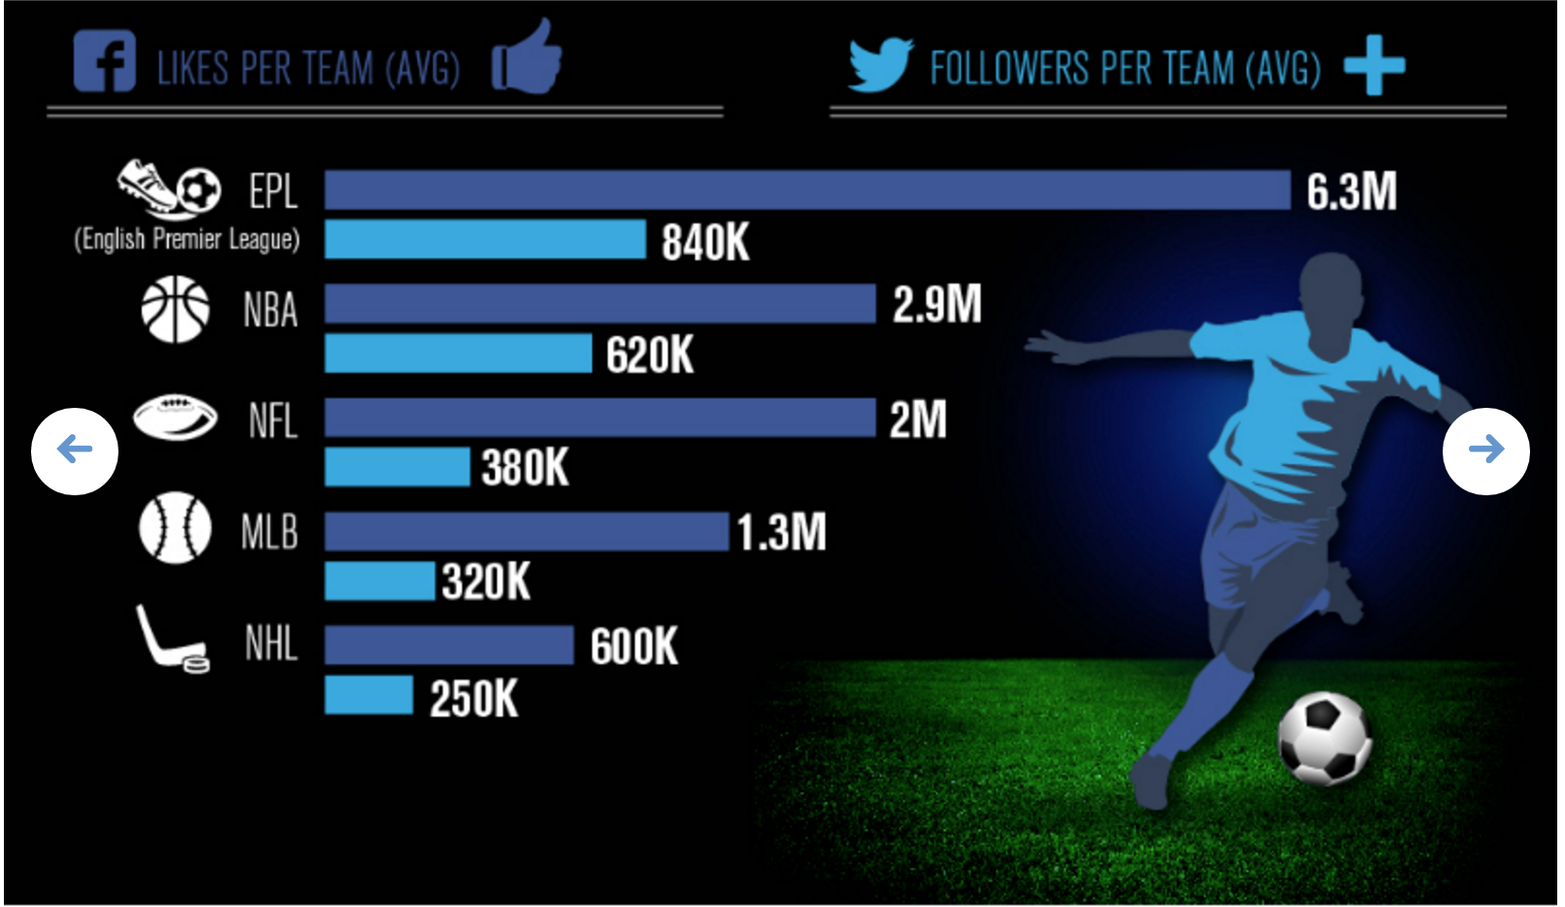
Flashback: #badvis
What representations are internal vs. external?

Slide 27
Pragmatic vs. Epistemic Action
Pragmatic actions move a person and their analysis closer to the desired destination.
Epistemic actions enable humans to leverage environmental structures to link internal structures.
The purpose of some actions is not for the effect they have on the environment but for the effect they have on the humans.

Slide 28
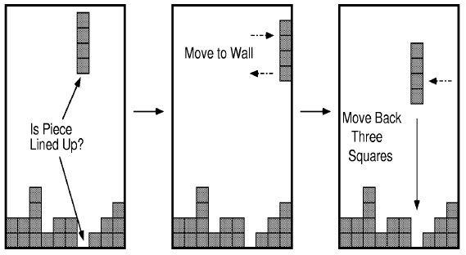
Example: Tetris

Slide 29
Part II
Interaction with
a Visual Interface

Slide 30
So far…
Visualization

Slide 31

Flashback: interaction as a reasoning aid
Interaction is situated in the context of a problem or goal-directed activity
Question: what kinds of things might someone want to do using a visualization?

Slide 32
Yi, Kang, Stasko and Jacko (2007)
Select: mark something as interesting
Explore: show me something else
Reconfigure: show me a different arrangement
Encode: show me a different representation
Abstract/Elaborate: show me more or less detail
Filter: show me something conditionally
Connect: show me related items
Select: mark something as interesting
Explore: show me something else
Reconfigure: show me a different arrangement
Encode: show me a different representation
Abstract/Elaborate: show me more or less detail
Filter: show me something conditionally
Connect: show me related items
Yi, J. S., ah Kang, Y., Stasko, J. T., & Jacko, J. A. (2007). Toward a deeper understanding of the role of interaction in information visualization. Visualization and Computer Graphics, IEEE Transactions on, 13(6), 1224-1231.

Slide 33
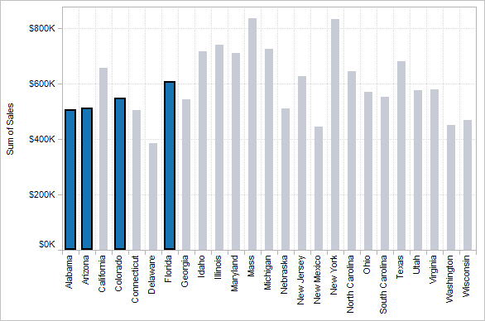
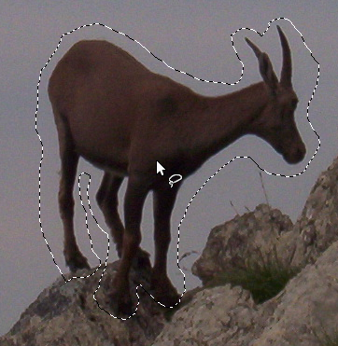

1. Select
Mark something as interesting: direct

Slide 34
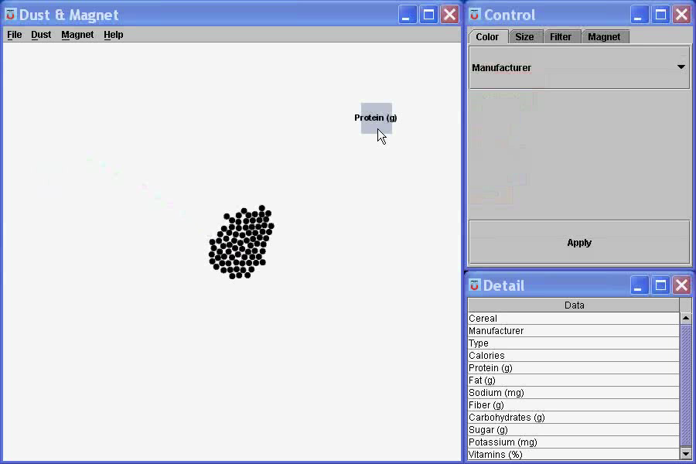
1. Select
Mark something as interesting: indirect
Notes:
What are you selecting? One item at a time?
Selecting of a value?
Selecting of a range?
Selecting of a position on the screen?

Slide 35
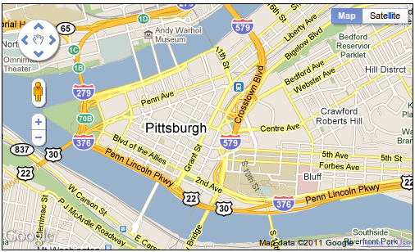
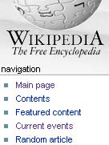
2. Explore
Show me something else
Scroll bars
Panning
Direct-Walk (e.g. hyperlink traversal)

Slide 36
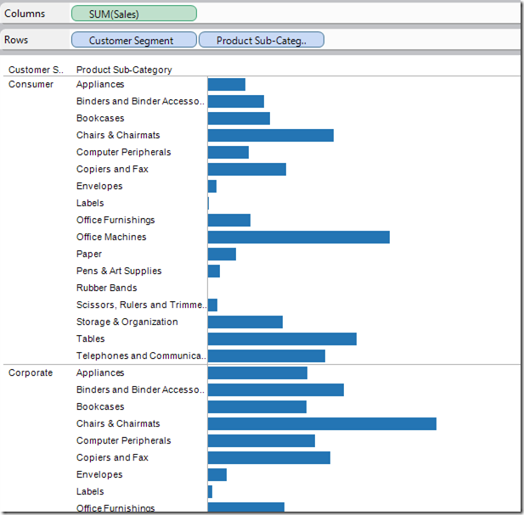
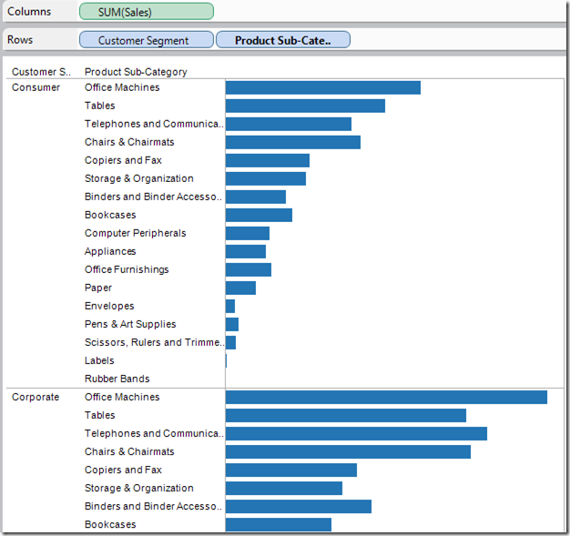
3. Reconfigure
Show me a different arrangement: sorting

Slide 37
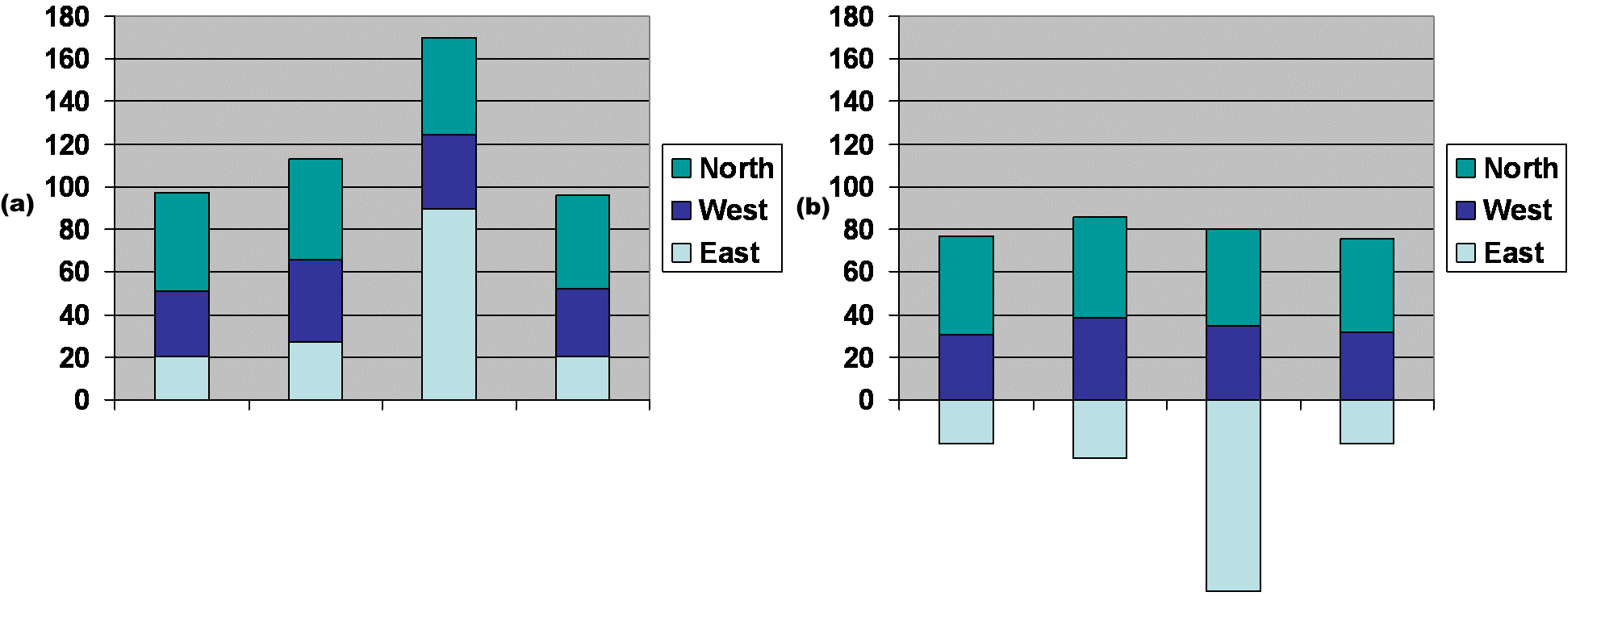
3. Reconfigure
Show me a different arrangement: baseline adjustment

Slide 38
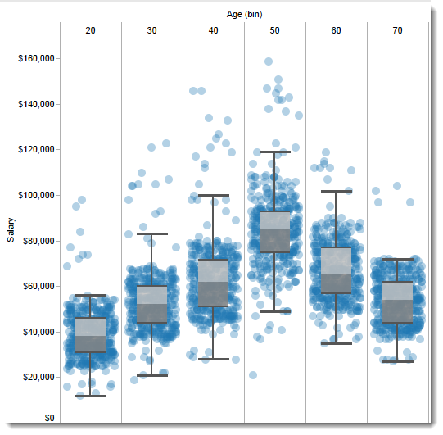
3. Reconfigure
Show me a different arrangement: reduce occlusion (jitter)

Slide 39
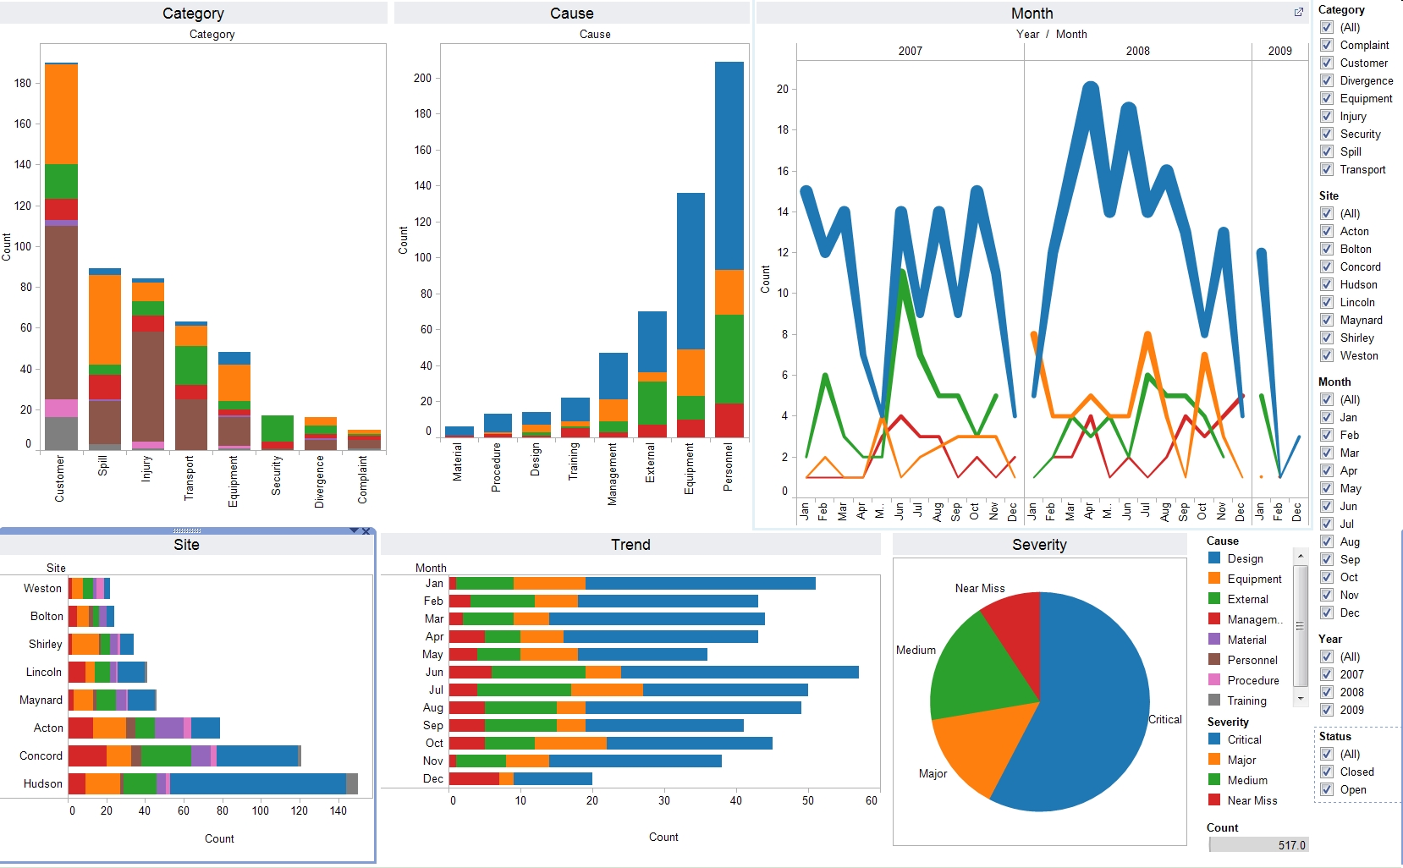
4. Encode
Show me a different representation: visualization type, color, size, orientation, etc.

Slide 40
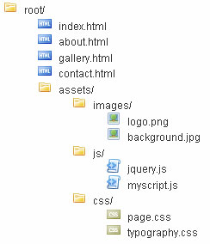
5. Abstract / Elaborate
Show me more or less detail: drill up/down

Slide 41
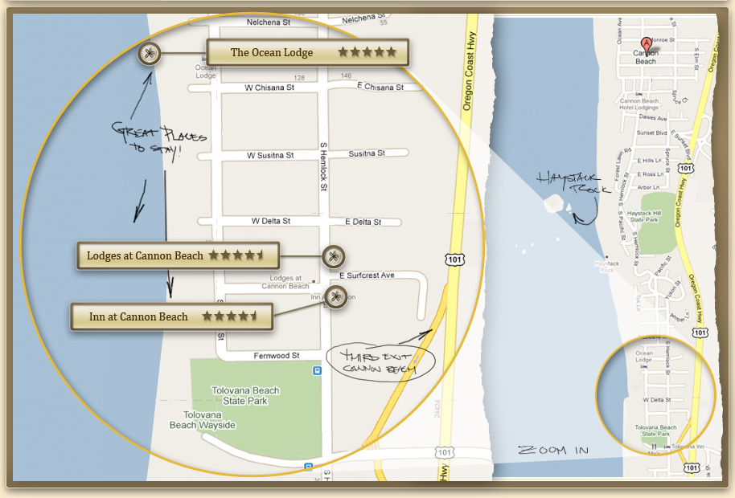
5. Abstract / Elaborate
Show me more or less detail: zooming

Slide 42
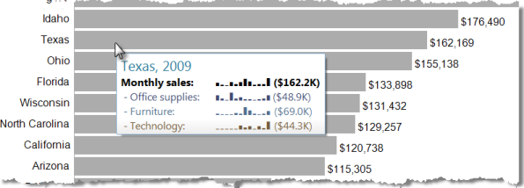
5. Abstract / Elaborate
Show me more or less detail: tooltips

Slide 43
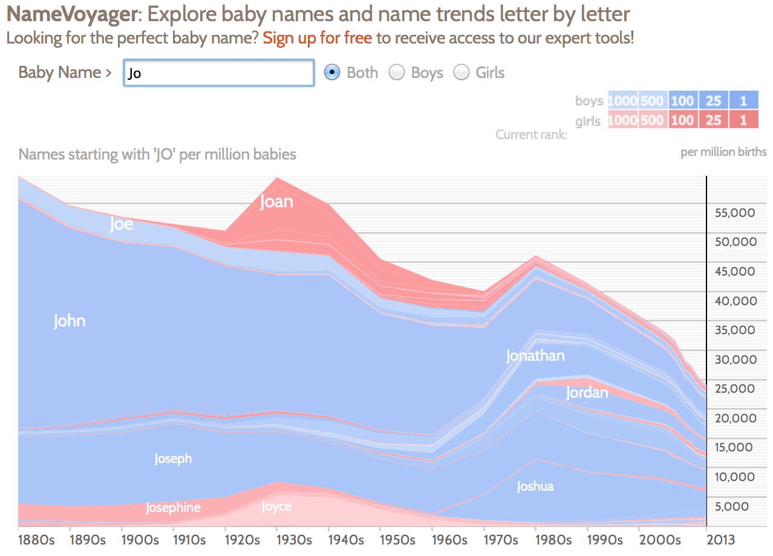
6. Filter
Show me something conditionally

Slide 44
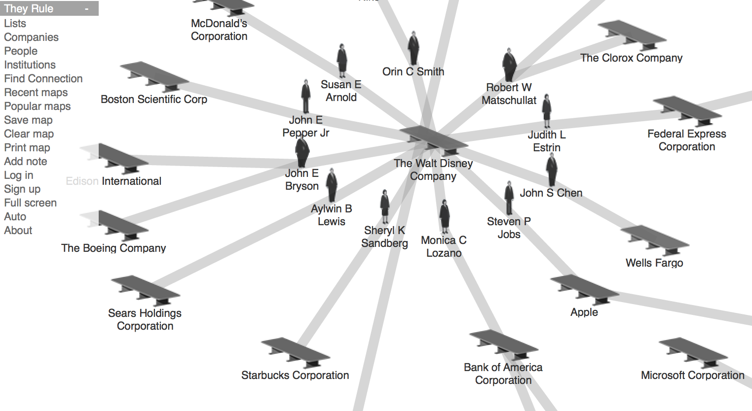
7. Connect
Show me related items: build-out

Slide 45
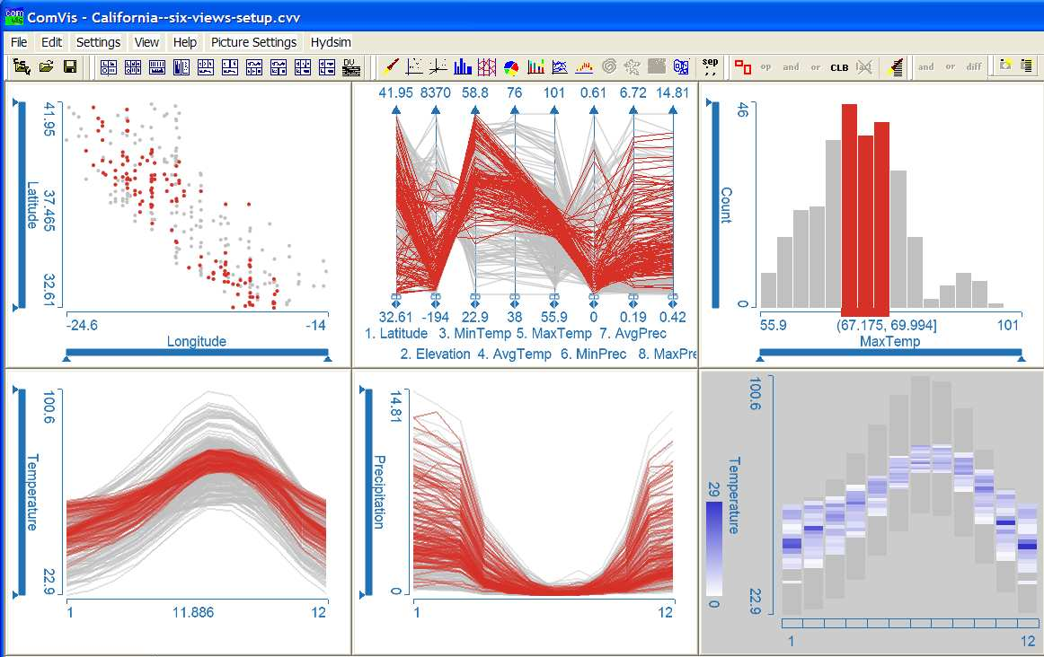
7. Connect
Show me related items: coordinated multiple views (CMV)

Slide 46
Discussion
Are these 7 interactions unambiguous?
Are there interactions missing?
Are some more costly than others?
Notes:
Missing: Higher-level concepts (e.g. ‘compare’)?

Slide 47
Suggested questions to ask when designing
What is the goal of the analysis?
Decision-making
Better understand a domain or a problem
Identify the trends of a phenomenon
Forecast the future
…etc.
What kinds of operations do we need to enable?
How can the visualization support those operations?

Slide 48
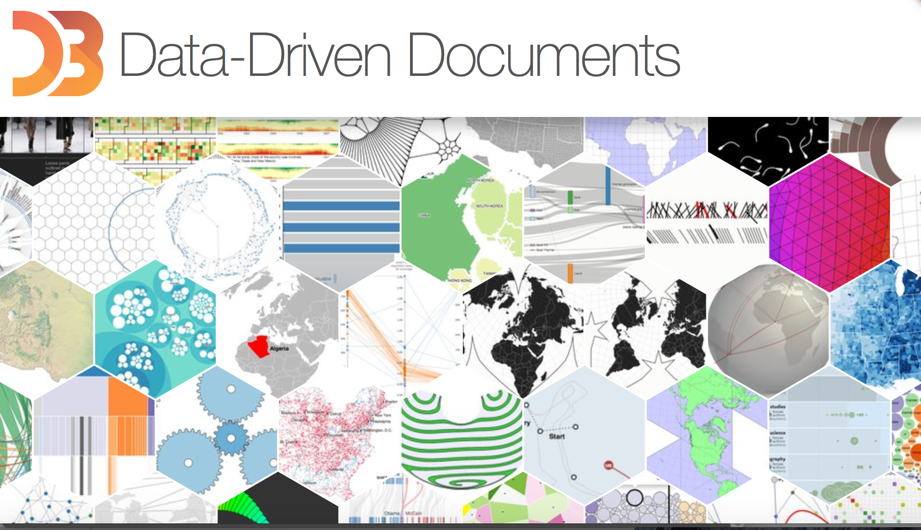

Slide 49
Outline
Introduction to D3
Lab – Building a Bar Chart with D3
Using HTML
Using SVG
Using external data, with bells & whistles
Discussion (time permitting)
Lab modeled on ““Let’s Make a Bar Chart” tutorial series by Mike Bostock, http://bost.ocks.org/mike/bar/.

Slide 50
D3.js
JavaScript library designed to make web-based visualization easier
Data transformation, rather than new representation
Visualization problems reduced to constructing and updating a DOM
DOM responds to changes in underlying data (stream or interaction)
Much of what follows comes from Mike Bostock's VIZBI 2012 workshop

Slide 51
Why use D3?
Uses existing web standards (HTML and SVG)
SVG has visual primitives: rect, circle, text, path, etc.
Low point of entry
Future-proofing
Compatibility with existing tools (like CSS and debuggers)
Use what you already know!
Use the browser's JavaScript console to debug interactively
Can build really powerful data-to-visual transformations

Slide 52
Selections
Selections of elements are D3’s atomic operand (much like jQuery)
d3.selectAll("circle") // return all elements with // the circle tag
Can select by any facet:
#foo // <any id="foo">
foo // <foo>
.foo // <any class="foo">
[foo=bar] // <any foo="bar">
foo bar // <foo><bar></foo>
Result is an array of elements that match description

Slide 53
Selection Example
// Select all <circle> elements
var circle = d3.selectAll("circle");
// Set some attributes and styles
circle.attr("cx", 20); // Center x value = 20
circle.attr("cy", 12); // Center y value = 12
circle.attr("r", 24); // radius = 24px
circle.style("fill", "red");

Slide 54
Selection Example
Method chaining allows shorter (and more readable) code.
// Select all <circle> elements
// and set some attributes and styles
d3.selectAll("circle")
.attr("cx", 20)
.attr("cy", 12)
.attr("r", 24)
.style("fill", "red");

Slide 55
Selection.append
To build dynamic visualizations, we need to be able to add new elements as well
var h1 = d3.selectAll("section")
.style("background", "steelblue")
.append("h1")
.text("Hello!");
Use caution with method chaining: append returns a new selection!

Slide 56
Mapping Data to Elements
Data are arrays
Could be numbers:
var data = [1, 1, 2, 3, 5, 8];
Or objects:
var data = [
{x: 10.0, y: 9.14},
{x: 8.0, y: 8.14},
{x: 13.0, y: 8.74}
];
D3 provides a pattern for managing the mapping from data to elements: enter(), update(), exit()

Slide 57
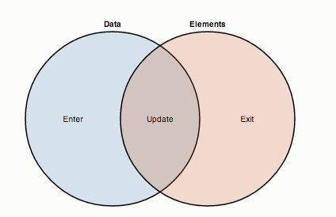
Thinking with joins (in 60 seconds)
.enter() figures out what’s changed in the dataset
.update() assigns data items to visual elements
.exit() cleans up things no longer being displayed

Slide 58
D3 Example
svg.selectAll("circle")
.data(data)
.enter().append("circle")
.attr("cx", x)
.attr("cy", y)
.attr("r", 2.5);
The first line may be surprising: why select <circle> elements that don’t exist yet?
=>You’re telling D3 that you want circles to correspond to data elements

Slide 59
D3 Example (Breakdown)
var circle = svg.selectAll("circle")
.data(data); // Data method computes the join, // defining enter() and exit()
// Appending to the enter selection
// creates the missing elements
circle.enter().append("circle")
.attr("cx", x(d) {
return d.x; // New elements are bound to }) // data, so we can compute
.attr("cy", y(d) { // attributes using accessor
return d.y; // functions
})
.attr("r", 2.5);

Slide 60
Working with External Data
CSV: d3.csv()
JSON: d3.json()
Database integration? Just need a (simple) web server
Data loaded asynchronously (browser won't stall)
Because everything is returned as an array, JavaScript's built in array functions work:
array.{filter,map,sort,…}
D3 also some additional data-transform methods; explore the API
d3.{nest,keys,values,…}
Up next: mapping from data space to visual space using scales

Slide 61
Ordinal Scales
Map a discrete domain to a discrete range
Essentially an explicit mapping
var x = d3.scale.ordinal()
.domain(["A", "B", "C", "D"])
.range([0, 10, 20, 30]);
x("B"); // 10
Often used to assign categorical colors
d3.scale.category20() // pre-assigned range w/
// 20 color categories

Slide 62
Quantitative Scales
Map a continuous (numeric) domain to a continuous range
var x = d3.scale.linear() // Others include sqrt(), pow() .domain([12, 24]) // log(), etc.
.range([0, 720]);
x(16); // 240
Typically, domains are derived from data:
.domain([0, d3.max(numbers)])
or
.domain(d3.extent(numbers)) // To compute min/max
// simultaneously
Sometimes, you may need a compound (“polylinear”) scale: the domain and range can have more than two values!

Slide 63
Line (and Area) Generators
Can use scales to generate lines and regions
var x = d3.scale.linear(),
y = d3.scale.linear();
var line = d3.svg.line() // Line generator
.x(function(d) { return x(d.x); })
.y(function(d) { return y(d.y); });
svg.append("path") // Pass data to the line generator
.datum(objects)
.attr("class", "line")
.attr("d", line);

Slide 64
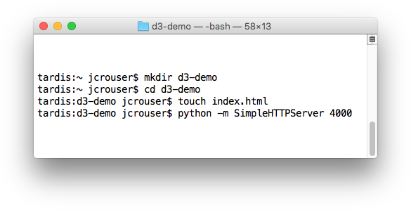
Let’s play!
Create a new directory
Create an empty index.html file inside the directory
Start up a little web server

Slide 65
Our data

Slide 66
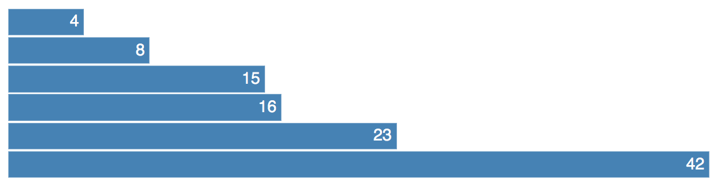
Our goal

Slide 67
Discussion
What are some of D3’s strengths? Weaknesses?
What are some of R’s strengths? Weaknesses?

